Slide 1
Programming Fundamentals
Lecture 20

Slide 2
Objectives
Overloading of >, < and == operators
Friend Functions
Friend Classes

Slide 3
Overloading > and < Operators
<, > and == are binary operators
These will be overloaded in the same way as we overloaded + operator
Example
  Define a class to handle the time in standard format Hrs: Mins: Secs and then overload the >, < and == operators to compare the times
  While overloading these operators the operator will return a bool
Code is attached with file name “overloading_logical_operators”

Slide 4
Friend Function (1/2)
An important feature of OOP is data hiding
It means only the member functions of a class can access its private data
But, sometimes this restriction may force programmer to write long and complex codes
So, there is mechanism built in C++ programming to access private or protected data from non-member functions
This is done by using a friend function or/and a friend class

Slide 5
Friend Function (2/2)
If a function is defined as a friend function then, the private and protected data of a class can be accessed using that function
The complier knows a given function is a friend function by the use of the keyword friend
For accessing the data, the declaration of a friend function should be made inside the body of the class (can be anywhere inside class either in private or public section) starting with keyword friend
The definition of friend function is made outside the class

Slide 6
Declaration and Definition of Friend Function
Declaration
  class class_name
  {
    …………
    friend return_type function_name(argument/s);
    …………
  };
Definition
  return_type function_name(argument/s)
  {
  //function body
  }

Slide 7
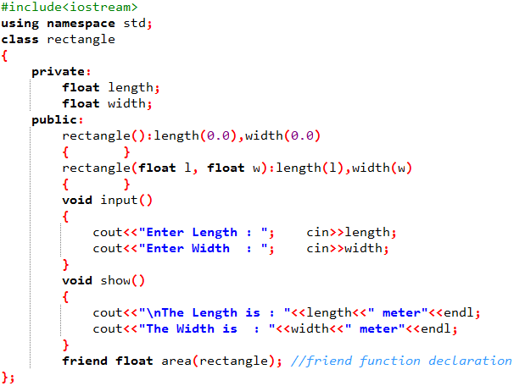
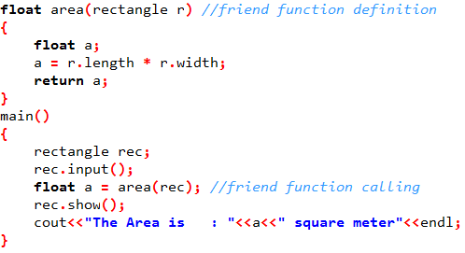
Friend Function (Example 1)

Slide 8
Friend Function for More than One Classes
A single function can be made a friend of more than one classes
In order to do so we need to declare the friend function in both classes
We also need to declare the classes in advance
The example on next slide will make it clear

Slide 9
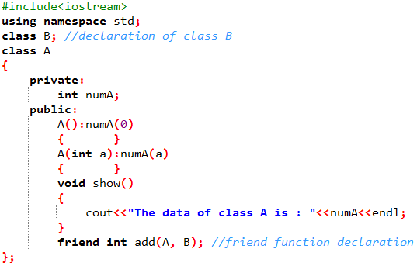
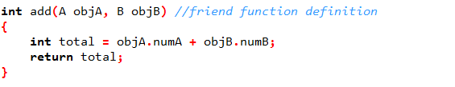
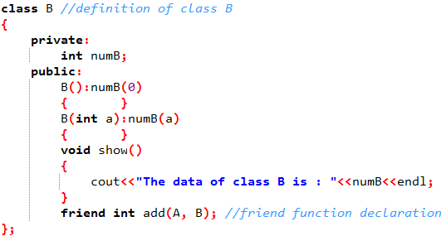
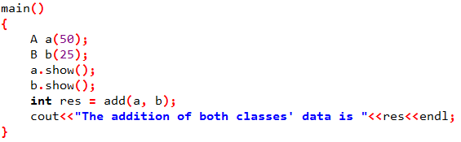
Friend Function (Example 2)

Slide 10
Member Function of a Class as a Friend Function for Another Class
Any member function of one class can be made a friend of other class
The declaration in this case will be like this
friend return_type class_name :: function_name(argument/s);
Suppose that we want to make a member function of “class A” a friend of “class B”
Here are the rules to remember
  Declare the class B before the class A
  Do not define the intended friend function inside the class A, just declare the function
  Declare the friend function inside class B by using friend keyword
  Define the friend function after the definitions of both classes

Slide 11
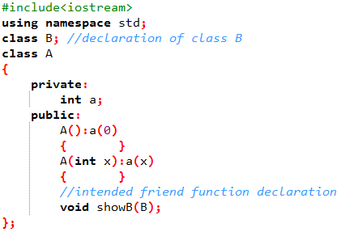
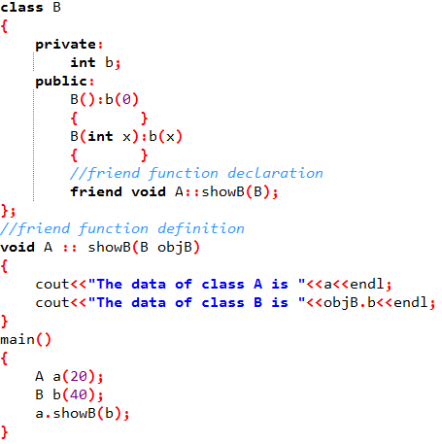
Friend Function (Example 3)

Slide 12
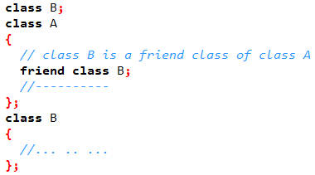
Friend Class
Like a friend function, a class can also be made a friend of another class using keyword friend
Friend class can access private and protected members of the class to which it is a friend
When a class is made a friend class, all the member functions of that class becomes friend functions

Slide 13
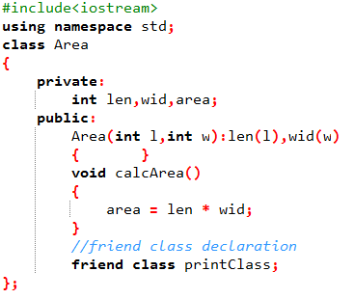
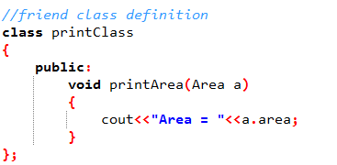
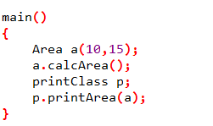
Friend Class (Example)

Slide 14
Friend Functions and Friend Classes (Points to Remember)
A friend function can be declared in the private or public section of the class
It can be called like a normal function without using the object and dot operator
A friend function is not in the scope of the class, of which it is a friend
A friend function is not invoked using the class object as it is not in the scope of the class
A friend function cannot access the private and protected data members of the class directly. It needs to make use of a class object and then access the members using the dot operator
A friend function can be a global function or a member of another class
Friendship among classes is not mutual
  If class A is a friend of class B, then A can access the private members of B but B cannot access the private members of class A

